Slide 1
COVID-19 ANALYSIS IN INDIA
Submitted By –
Amit Ramesh Jaiswal

Slide 2
What is COVID-19 ?
Coronavirus disease 2019 (COVID-19) is defined as illness caused by a novel coronavirus now called severe acute respiratory syndrome coronavirus 2 (SARS-CoV-2; formerly called 2019-nCoV), which was first identified amid an outbreak of respiratory illness cases in Wuhan City, Hubei Province, China. It was initially reported to the WHO on December 31, 2019. On January 30, 2020, the WHO declared the COVID-19 outbreak a global health emergency. On March 11, 2020, the WHO declared COVID-19 a global pandemic, its first such designation since declaring H1N1 influenza a pandemic in 2009.

Slide 3
When The First Covid-19 infected Patient Reported in India ?
The first Covid-19 case in India was reported on 30th January 2020 in South Indian state of Kerala on a medical student who was pursuing the studies at Wuhan University, China. Two more students were found to be infected in Kerala in the consecutive days. The Kerala government was successful in containing the disease with its proactive measures back then. The second outbreak of Covid-19 in India started in the first week of March from various parts of India in various people who visited the foreign countries and in some of the tourists from different countries.
Video Link - https://drive.google.com/file/d/1lhBluYuZT3uLaf8Ys84zPdd-Wz5kTE3v/view?usp=sharing

Slide 4
Executed Summary
This data set consists of the following data:
State-wise statistics - Confirmed, Active, Recovered, Deceased cases
day-wise count of infected and deceased from various states
Statistics from Kerala - day-wise count of confirmed, Active, Recovered, Deceased cases
Statistics from Kasaragod district, Kerala - day-wise count of confirmed, Active, Recovered, Deceased cases
Count of confirmed cases from various districts of India
DATASET LINK- https://www.kaggle.com/ambilidn/covid19-dataset- india?select=State-wise+statistics.xlsx

Slide 5
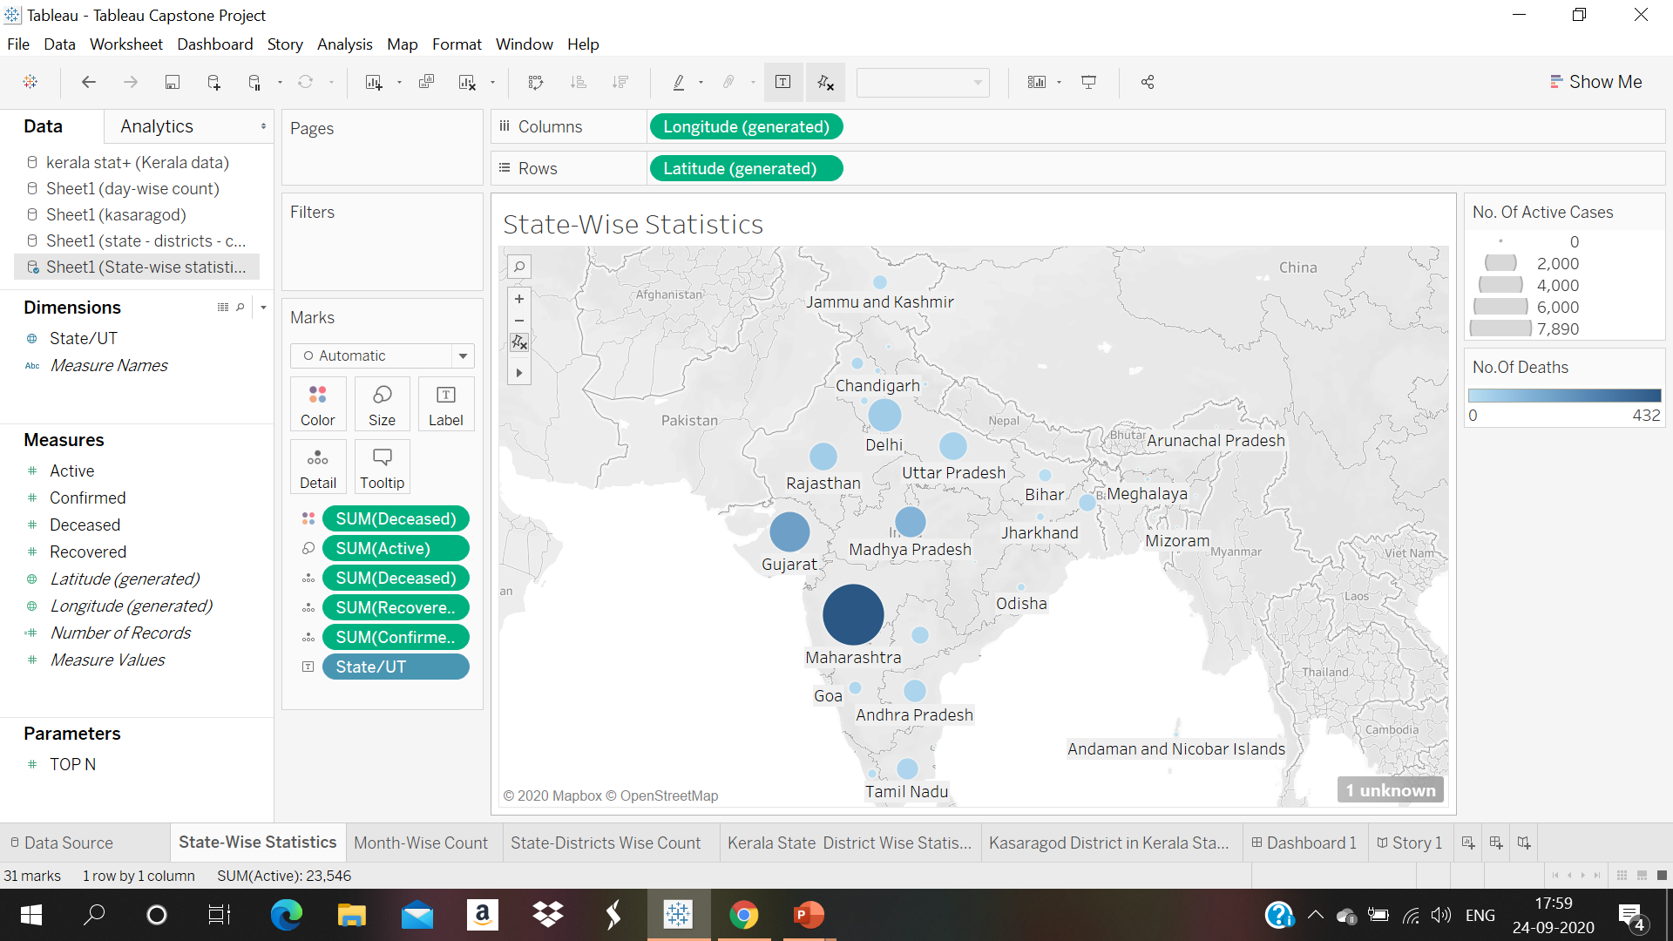
Objective – 1
State-wise number of infected and number of death count in India map. Hover the mouse on each state in the India map to know the count.
Result:
Confirmed=37,257
Active=26,025
Recovered=10,005
Deseased =1,223

Slide 6
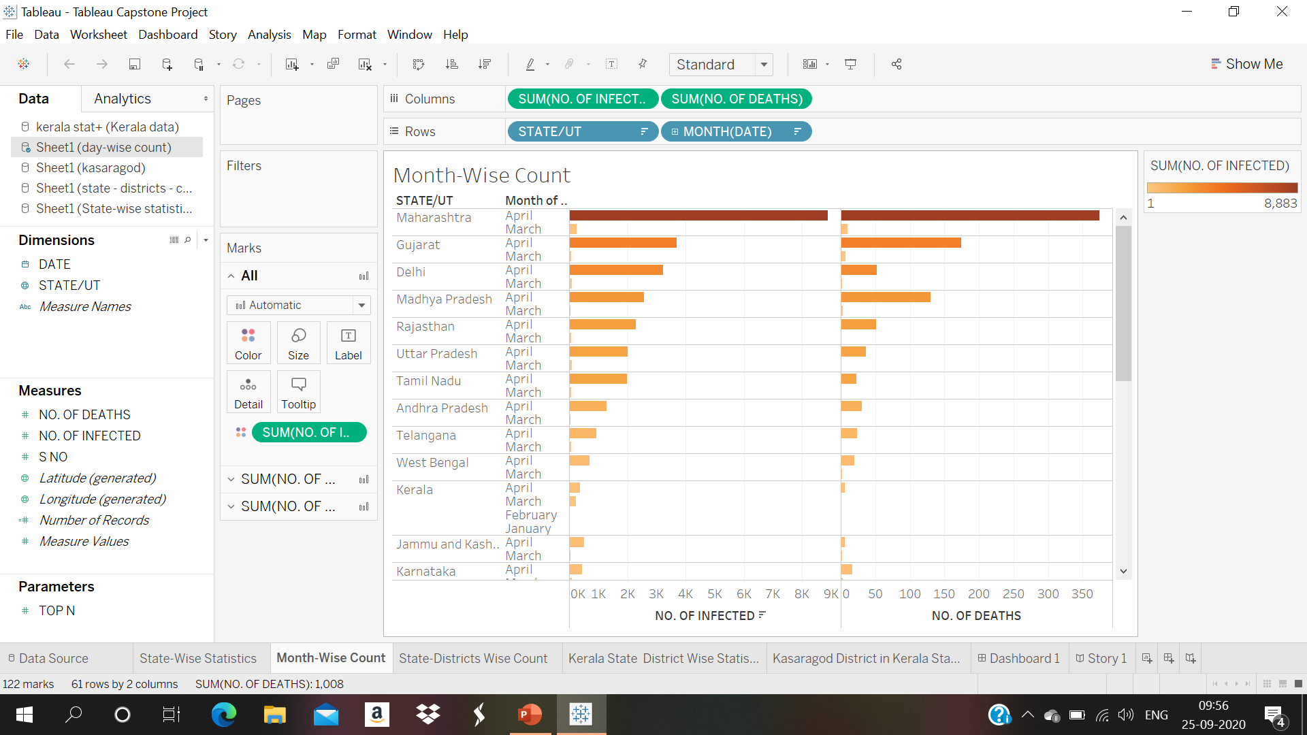
Objective – 2
Month-wise count of infected and deceased from various states
Result:
Worst affected states at states are Maharashtra and Gujrat more than 1000 cases are reported in month of April.

Slide 7
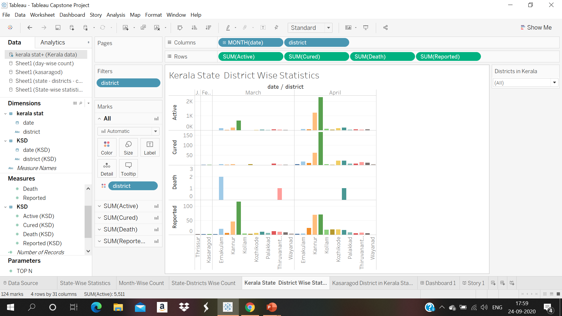
Objective – 3
Statistics from Kerala - day-wise count of confirmed, Active, Recovered, Deceased cases
Result:
Confirmed = 497
Active =111(22.33%)
Recovered =383(77.06%)
Deseased =03(0.6%)

Slide 8
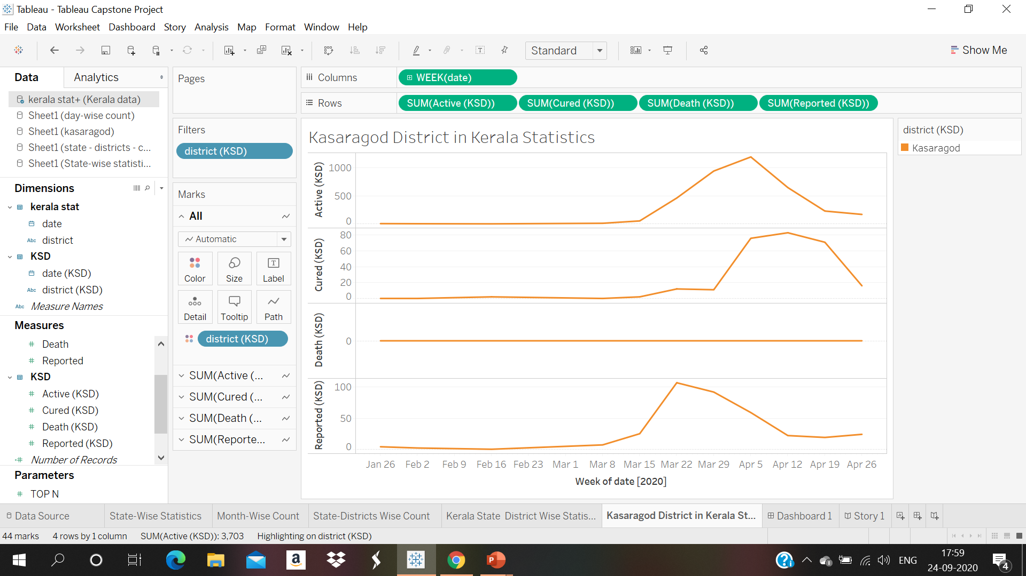
Objective – 4
Statistics from Kasaragod district, Kerala - day-wise count of confirmed, Active, Recovered, Deceased cases
Result:
District = Kasaragod
Confirmed =179
Active = 12
Recovered = 167
Death = 0

Slide 9
Have a look at the top most district of kerala – “Kasaragod”. How did they manage to flatten the curve so fast?
1)People supported the government of kerala by following rules.
2)Police force played a vital Role.
3)Strong Healthcare System.
4)Aggressive Testing in the initial stage especially for those who are coming from other countries.
5)Effective Contact Tracing and Quarantine Measure.

Slide 10
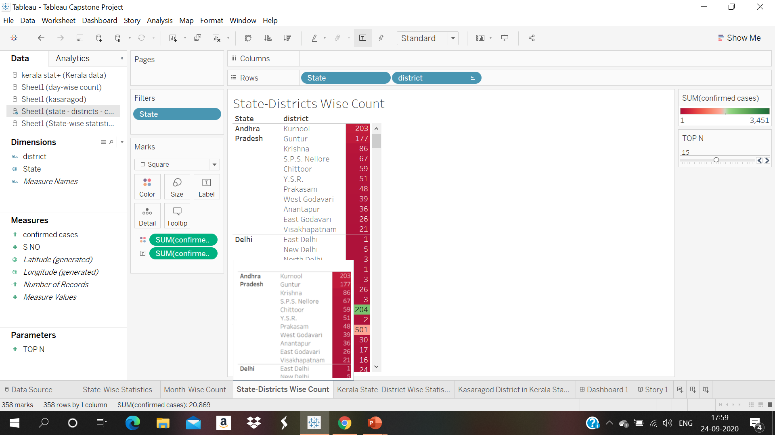
Objective – 5
State –District wise count of confirmed, Active, Recovered, Deceased cases
Result:
Worst affected states at states are Maharashtra and Gujrat more than 1000 cases are reported in month of April and in Maharshtra state this are some district are mostly affected – Mumbai, Pune, Thane, Palghar and in Gujrat –Ahmedabad, Surat, vadodara

Slide 11
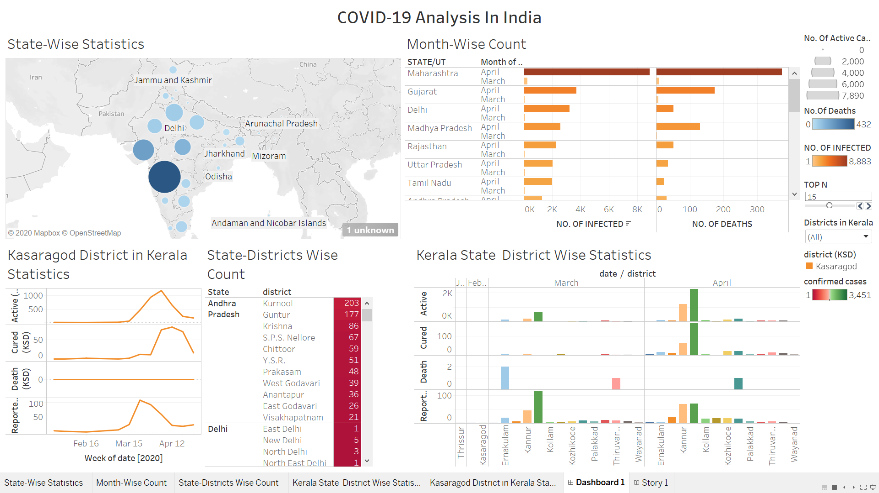
Dashboard

Slide 12
Conclusion
Protect yourself and others from COVID-19
1) You can reduce your chances of being infected or spreading COVID-19 by taking some simple precautions:
2)Regularly and thoroughly clean your hands with an alcohol-based hand rub or wash them with soap and water. Why? Washing your hands with soap and water or using alcohol-based hand rub kills viruses that may be on your hands.
3) Maintain at least 1 metre (3 feet) distance between yourself and others. Why? When someone coughs, sneezes, or speaks they spray small liquid droplets from their nose or mouth which may contain virus. If you are too close, you can breathe in the droplets, including the COVID-19 virus if the person has the disease.
4) Avoid going to crowded places. Why? Where people come together in crowds, you are more likely to come into close contact with someone that has COVID-19 and it is more difficult to maintain physical distance of 1 metre (3 feet).
5) Governments should encourage the general public to wear a fabric mask if there is widespread community transmission, and especially where physical distancing cannot be maintained.
6) Avoid touching eyes, nose and mouth. Why? Hands touch many surfaces and can pick up viruses. Once contaminated, hands can transfer the virus to your eyes, nose or mouth. From there, the virus can enter your body and infect you.
7) Make sure you, and the people around you, follow good respiratory hygiene. This means covering your mouth and nose with your bent elbow or tissue when you cough or sneeze.

Slide 13
Thank You

